Slide 1


Modeling with
modelr
Slides CC-BY-SA RStudio

Slide 2
Navigate to the 04-Model folder. Open 04-Model-Exercises.Rmd
2

Slide 3


The basics

Slide 4
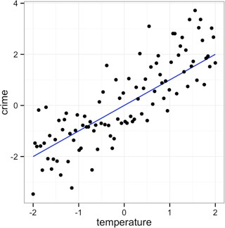
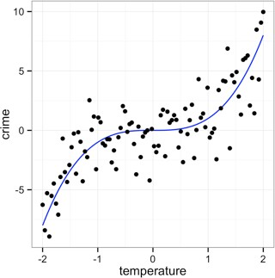
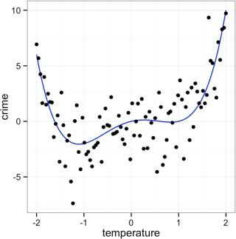

Models
A low dimensional description of a higher dimensional data set.
4
modelr

Slide 5

Models
Algorithm
Data
Model Function

Slide 6













Models
What is the model function?
Algorithm
Data
Model Function

Slide 7


Models
What uncertainty is associated with it?
Algorithm
Data
Model Function

Slide 8
Models
How "good" is the model?
Algorithm
Data
Model Function

Slide 9
Models
What are the residuals?
Algorithm
Data
Model Function

Slide 10







Models
What are the predictions?
Algorithm
Data
Model Function

Slide 11

hm Algorithm
Algorithm
Algorithm
Algorithm
Algorithm
Algorithm
Algorithm
Algorithm
Algorithm
Algorithm
Algorithm Alg
hm Algorithm
Algorithm
Algorithm
Algorithm
Algorithm
Algorithm
Algorithm
Algorithm
Algorithm
Algorithm
Algorithm Alg
hm Algorithm
Algorithm
Algorithm
Algorithm
Algorithm
Algorithm
Algorithm
Algorithm
Algorithm
Algorithm
Algorithm Alg
Algorithm
hm Algorithm
Algorithm
Algorithm
Algorithm
Algorithm
Algorithm
Algorithm
Algorithm Alg
hm Algorithm
Algorithm
Algorithm
Algorithm
Algorithm
Algorithm
Algorithm
Algorithm
Algorithm
Algorithm
Algorithm Alg
hm Algorithm
Algorithm
Algorithm
Algorithm
Algorithm
Algorithm
Algorithm
Algorithm
Algorithm
Algorithm
Algorithm Alg

Slide 12
(Popular) modeling functions in R
function | package | fits
lm() | stats | linear models
glm() | stats | generalized linear models
gam() | mgcv | generalized additive models
glmnet() | glmnet | penalized linear models
rlm() | MASS | robust linear models
rpart() | rpart | trees
randomForest() | randomForest | random forests
xgboost() | xgboost | gradient boosting machines
modelr

Slide 13
(Popular) modeling functions in R
function | package | fits
lm() glm() | stats stats | linear models generalized linear models
gam() | mgcv | generalized additive models
glmnet() | glmnet | penalized linear models
rlm() | MASS | robust linear models
rpart() | rpart | trees
randomForest() | randomForest | random forests
xgboost() | xgboost | gradient boosting machines
modelr

Slide 14
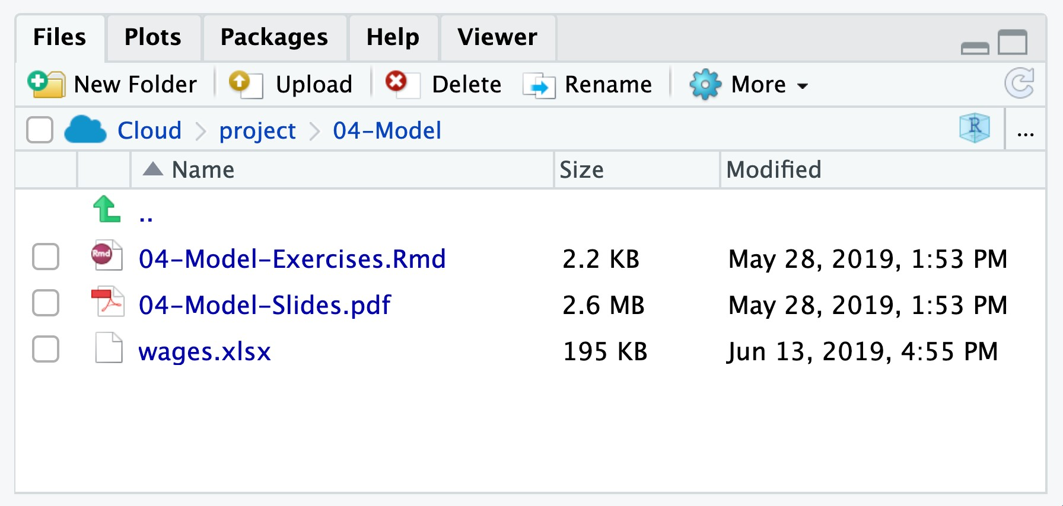
wages.xlsx
Income predictors extracted from the National Longitudinal Study, sponsored by the U.S. Bureau of Labor Statistics.
modelr

Slide 15

Your Turn 1
Change the working directory to 04-Models.
Then import wages.xlsx as wages and copy the code to your setup chunk.
Be sure to set NA: to NA.
15

Slide 16
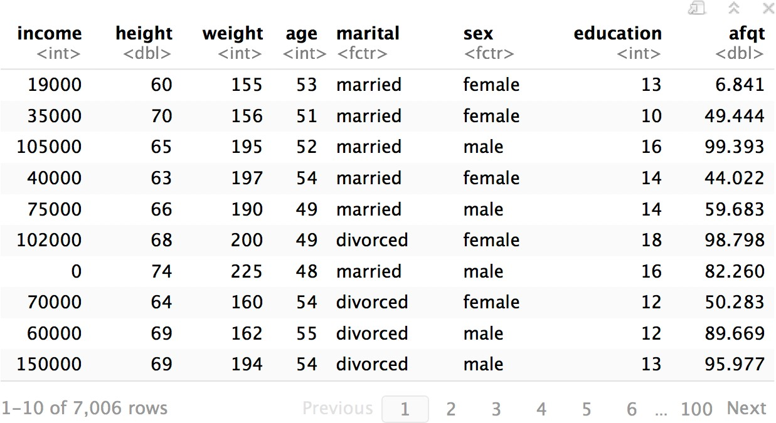
wages
modelr

Slide 17
wages %>%
ggplot(aes(log(income))) + geom_histogram(binwidth = 0.25)
600
400
count
200
0
5.0
7.5
log(income)
10.0
12.5
modelr

Slide 18

lm()

Slide 19
lm()
Fit a linear model to data
lm(log(income) ~ education, data = wages)
A formula that describes the model equation
The data set
19
modelr

Slide 20
formulas
Formula only needs to include the response and predictors
y = ↵ + Ø
+ ✏
y
x
y ~ x
y ~ x
The predictors
20
Response
A tilde
modelr

Slide 21

Your Turn 2
Fit the model below and then examine the output. What does it look like?
mod_e <- lm(log(income) ~ education, data = wages)
21

Slide 22
mod_e <- lm(log(income) ~ education, data = wages)
mod_e
## Call:
## lm(formula = log(income) ~ education, data = wages)
## 1. Not pipe friendly to
have data as second argument :(
## ## | Coefficients: (Intercept) | education
## | 8.5577 | 0.1418
class(mod_e) ## "lm"
2. Output is not tidy, or even a data frame
22

Slide 23
.
Use "." to pipe input to somewhere other than the first argument
mod_e <- wages %>%
lm(log(income) ~ education, data = .)
wages will be passed to here
23
modelr

Slide 24
broom

Slide 25
broom
Turns model output into data frames
# install.packages("tidyverse") library(broom)
25

Slide 26
broom
Broom includes three functions which work for most types of models (and can be extended to more):
tidy() - returns model coeﬀicients, stats
glance() - returns model diagnostics
augment() - returns predictions, residuals, and other raw values
26

Slide 27
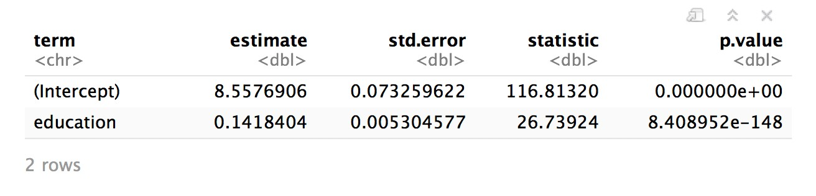
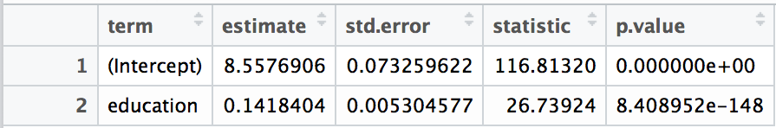
tidy()
Returns useful model output as a data frame
mod_e %>% tidy()
27

Slide 28
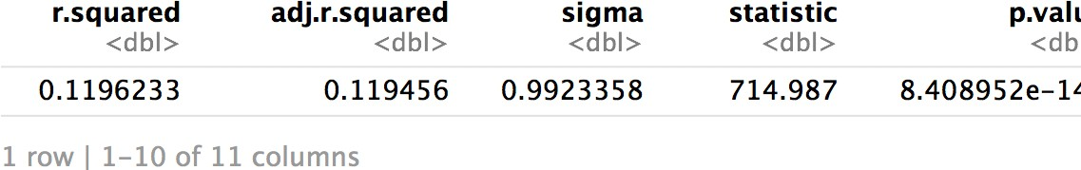
glance
Returns common model diagnostics as a data frame
mod_e %>% glance()
28

Slide 29
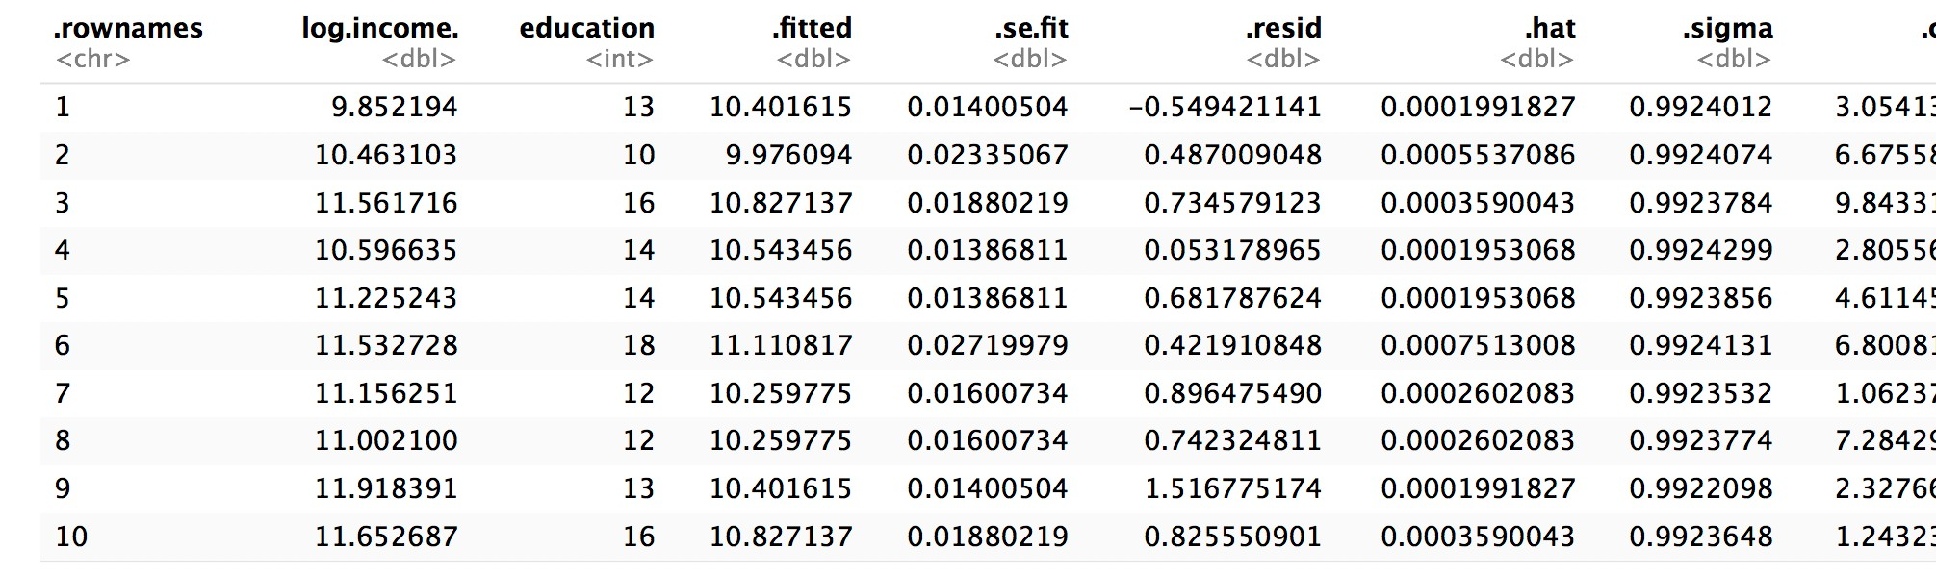
augment()
Returns data frame of model output related to original data points
mod_e %>% augment()

Slide 30
augment()
Returns data frame of model output related to original data points
mod_e %>% augment(data = wages)
Adds the original wages data set to the output
30

Slide 31

Your Turn 3
Use a pipe to model log(income) against height. Then use broom and dplyr functions to extract:
The coeﬀicient estimates and their related statistics
The adj.r.squared and p.value for the overall model
31

Slide 32
mod_h <- wages %>% lm(log(income) ~ height, data = .)
mod_h %>%
tidy()
## |  | term | estimate | std.error | statistic | p.value
## | 1 | (Intercept) | 6.98342583 | 0.237484827 | 29.40578 | 4.129821e-176
## | 2 | height | 0.05197888 | 0.003521666 | 14.75974 | 2.436945e-48
mod_h %>% glance() %>%
select(adj.r.squared, p.value)
## adj.r.squared p.value ## 1 0.03955779 2.436945e-48
32

Slide 33
mod_h %>%
tidy() %>% filter(p.value < 0.05)
## |  | term | estimate | std.error | statistic | p.value
## | 1 | (Intercept) | 6.98342583 | 0.237484827 | 29.40578 | 4.129821e-176
## | 2 | height | 0.05197888 | 0.003521666 | 14.75974 | 2.436945e-48
mod_e %>%
tidy() %>% filter(p.value < 0.05)
so which determines income?
## |  | term | estimate | std.error | statistic | p.value
## | 1 | (Intercept) | 8.5576906 | 0.073259622 | 116.81320 | 0.000000e+00
## | 2 | education | 0.1418404 | 0.005304577 | 26.73924 | 8.408952e-148
33

Slide 34
multivariate
regression

Slide 35
To fit multiple predictors,
add multiple variables to the formula:
log(income) ~ education + height
35

Slide 36
mod_eh <- wages %>%
lm(log(income) ~ education + height, data = .)
mod_eh %>% tidy()
## |  | term | estimate | std.error | statistic | p.value
## | 1 | (Intercept) | 5.34837618 | 0.231320415 | 23.12107 | 1.002503e-112
## | 2 | education | 0.13871285 | 0.005205245 | 26.64867 | 7.120134e-147
## | 3 | height | 0.04830864 | 0.003309870 | 14.59533 | 2.504935e-47
36

Slide 37
Your Turn 4
Model log(income) against education and height and
sex. Can you interpret the coeﬀicients?
37

Slide 38
mod_ehs <- wages %>%
lm(log(income) ~ education + height + sex, data = .)
mod_ehs %>% tidy()
##
Where is sexfemale?
What does this mean?
term
estimate
7.79
std.error
0.307
statistic
25.3
p.value 9.41e-134
## 1 (Intercept)
## | 1 | 2 | education | 0.148 | 0.00520 | 28.5 | 5.16e-166
## | 1 | 3 | height | 0.00673 | 0.00479 | 1.40 | 1.61e- 1
## | 1 | 4 | sexmale | 0.462 | 0.0389 | 11.9 | 5.02e- 32
38

Slide 39
p.value 9.41e-134
## term
## 1 (Intercept)
estimate
7.79
std.error
0.307
statistic
25.3
## | 1 | 2 | education | 0.148 | 0.00520 | 28.5 | 5.16e-166
## | 1 | 3 | height | 0.00673 | 0.00479 | 1.40 | 1.61e- 1
## | 1 | 4 | sexmale | 0.462 | 0.0389 | 11.9 | 5.02e- 32
Mean log(income) for a female (baseline) is: log(income) = 7.79 + 0.15 * education + 0 * height
Mean log(income) for a male (baseline + adjustment) is: log(income) = 7.79 + 0.15 * education + 0 * height + 0.46
39

Slide 40
model
visualization

Slide 41
Your Turn 5
Add + geom_smooth(method = lm) to the code below. What happens?
wages %>%
ggplot(aes(x = height, y = log(income))) + geom_point(alpha = 0.1)
41

Slide 42
wages %>%
ggplot(aes(x = height, y = log(income))) + geom_point(alpha = 0.1) + geom_smooth(method = lm)
12.5
Fits y ~ x
(mod_h)
10.0
log(income)
7.5
5.0
60
70
80
height

Slide 43
geom_smooth()
Adds model line for predicting y ~ x (default).
p + geom_smooth(method = lm, se = TRUE, …)
An R modeling function to use to generate the line
Include standard error bars?
Other args to pass to modeling function
What about complex
models, or residuals?
43

Slide 44



modelr
Tidy functions that make it easier to work with models in R
# install.packages("tidyverse") library(modelr)
modelr
44
modelr

Slide 45
add_predictions()
Uses the values in a data frame to generate a prediction for each case. Can be new data.
add_predictions(data, model, var = "pred")
Gives new column this name
To add predictions to these cases
Uses this model
45
modelr

Slide 46
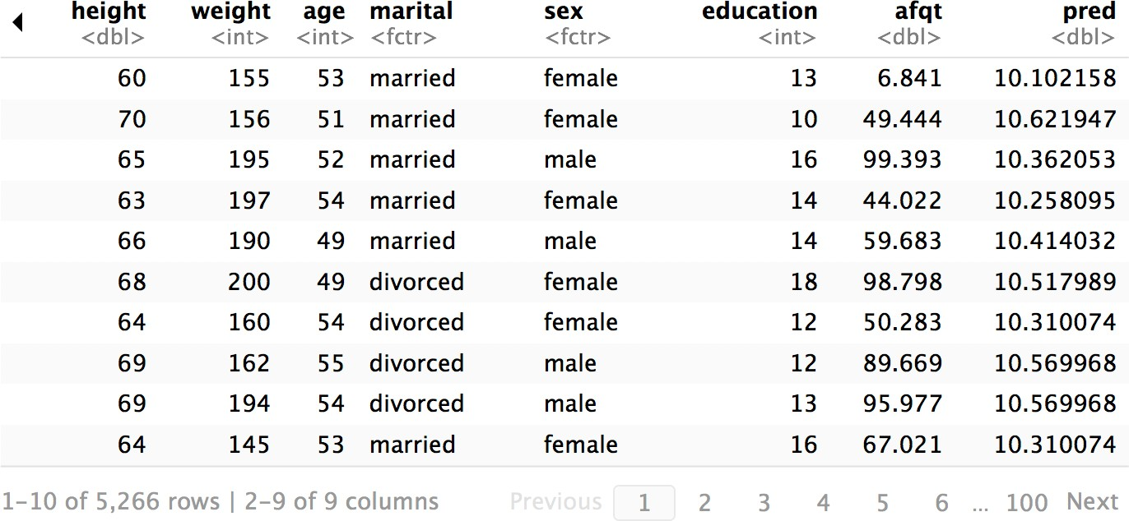
wages %>% add_predictions(mod_h)
modelr

Slide 47
add_residuals()
Uses the values in a data frame to generate a residual for each case. Overlaps with augment()*
add_residuals(data, model, var = "resid")
Gives new column this name
To add residuals to these cases
Uses this model
47
modelr

Slide 48
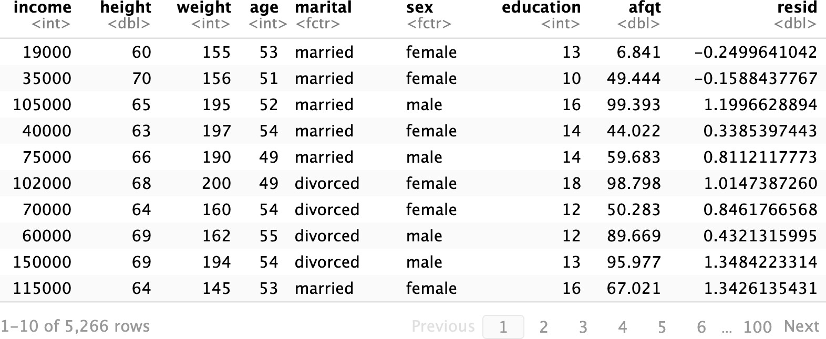
wages %>% add_residuals(mod_h)
modelr

Slide 49
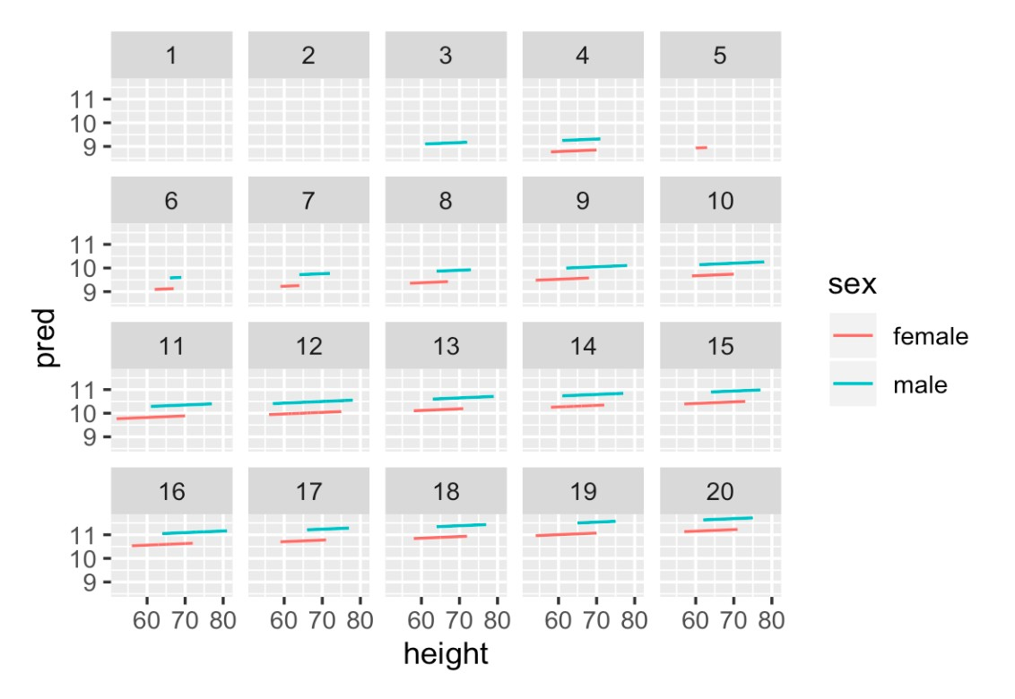

Your Turn 6
Use add_predictions to make the plot below.
49

Slide 50
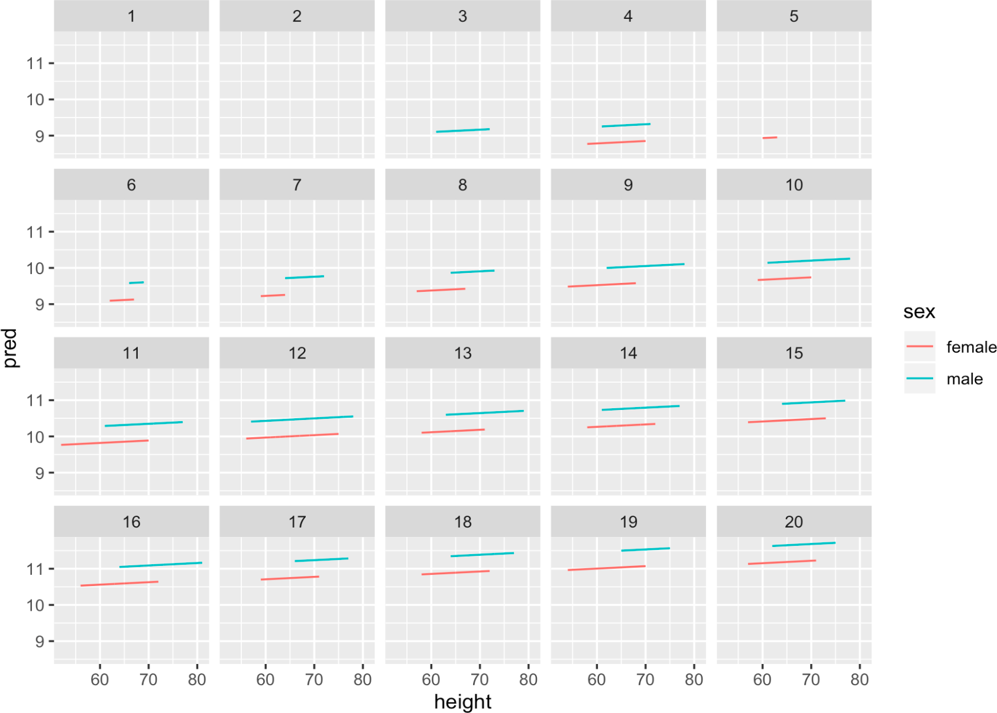
wages %>%
add_predictions(mod_ehs) %>%
ggplot(mapping = aes(x = height, y = pred, color = sex)) + geom_line() +
facet_wrap(~ education)

Slide 52
spread_residuals()
Adds residuals for multiple models, each in their own column.
spread_residuals(data, …)
Adds residuals from each of these models
To the cases in this data frame
52
modelr

Slide 53
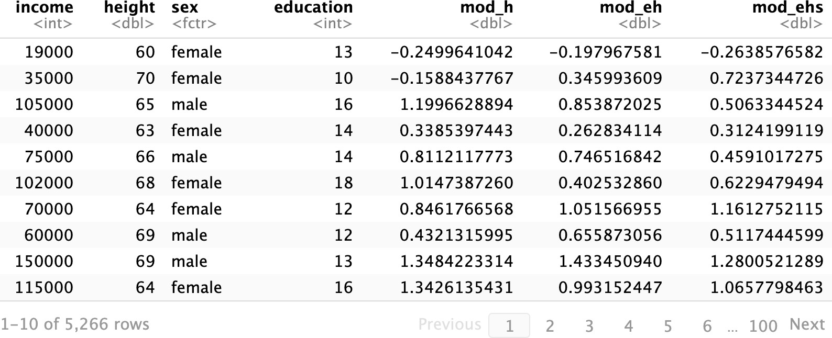
wages %>%
spread_residuals(mod_h, mod_eh, mod_ehs)
modelr

Slide 54
gather_residuals()
Adds residuals for multiple models as a pair of key:value columns (model:resid)
gather_residuals(data, …)
To the cases in this data frame (duplicating rows as necessary)
Adds residuals from each of these models
54
modelr

Slide 55
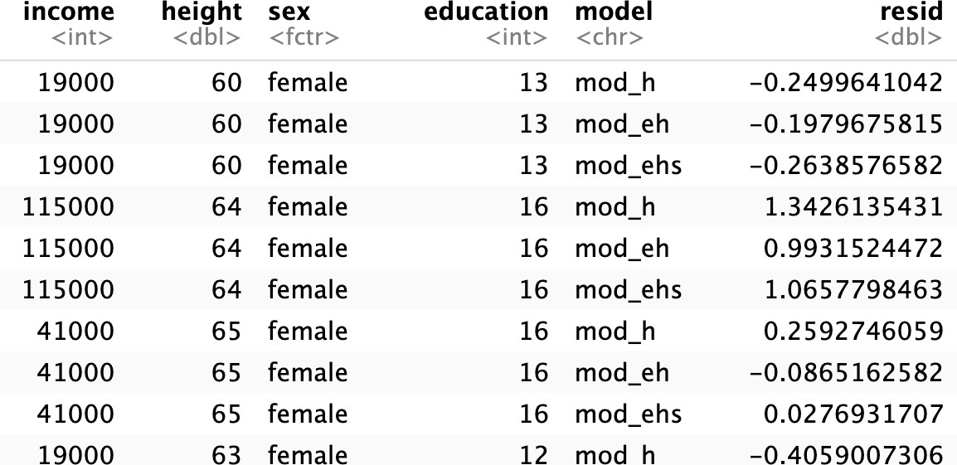
wages %>%
gather_residuals(mod_h, mod_eh, mod_ehs)
modelr

Slide 56
Predications
Modelr provides the equivalent functions for predictions
add_residuals() spread_residuals() gather_residuals()
add_predictions()
spread_predictions() gather_predictions()
56
modelr

Slide 57


Recap
Use glance(), tidy(), and augment() to return model values in a data frame.
Use add_predictions() or gather_predictions()
or spread_predictions() to visualize predictions.
modelr
Use add_residuals() or gather_residuals() or
spread_residuals() to visualize residuals.
modelr
57

Slide 58
Modeling with
modelr
Slides CC-BY-SA RStudio

